Slide 1
BFOE Market Dynamics / Brent Book Leadership / Trading Opportunities /
August 2018
Jack Pearson, Paul Butcher

Slide 2
Agenda
What is Dated Brent & how is it calculated?
Dated Brent vs ICE Brent & Hedging Instruments
Factors influence Dated / ICE Spread
Brent Book Concept
Brent Book Mechanisms

Slide 3
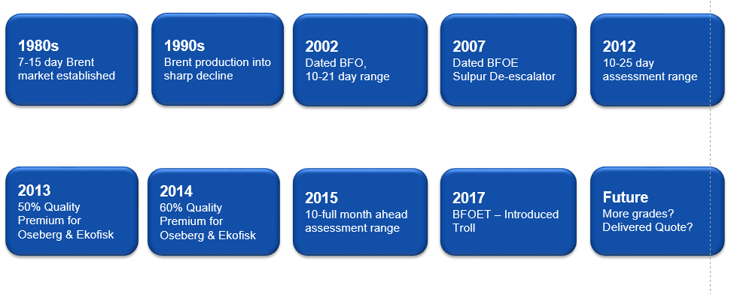
What is Dated Brent / BFOET?
Dated Brent ($/bbl.) = the weighted average of the cheapest cargoes of Brent, Forties, Oseberg, Ekofisk, Troll (adjusted for Q.P’s) loading in the next 10-30 days
BFOET : Brent, Forties, Oseberg, Ekofisk, Troll (North Sea Light Sweet Crudes)
Benchmark for ~70% of crude grades globally (others on WTI/Dubai):
Price = Dated Brent + Quality Differential + Freight + Other Costs
Platts is typically the industry used publication

Slide 4
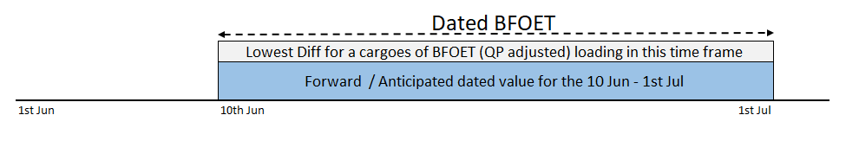
How is Dated Brent assessed?
Platts Assessment Formula 1st June
Dated Brent 1st June = ICE Brent August + EFP August + CFD 10-30 June + Lowest BFOET Diff 10-30 June
Forward BFOET
ICE Brent Front Month = August

Slide 5
CFD’s (Contract for Difference)
CFD = Dated – Forward (swap contract)
CFD’s typically quoted weekly and curve from 10-30 days out impacts Dated Brent
CFD’s are used as hedging mechanisms but also as speculative tools (cash settlement)
Sometimes see a disconnect between the CFD and ICE curves (e.g. CFD in contango but ICE in backwardation)
Participants
CFD’s mainly trade within the Platts MOC process with ~30 participants
Main players: Gunvor, BP, Onyx, Mercuria, Glencore, Vitol
Participants include those with no physical position (e.g. Onyx, Mandara) - exploit arb between DFL, CFD intra day spreads

Slide 6
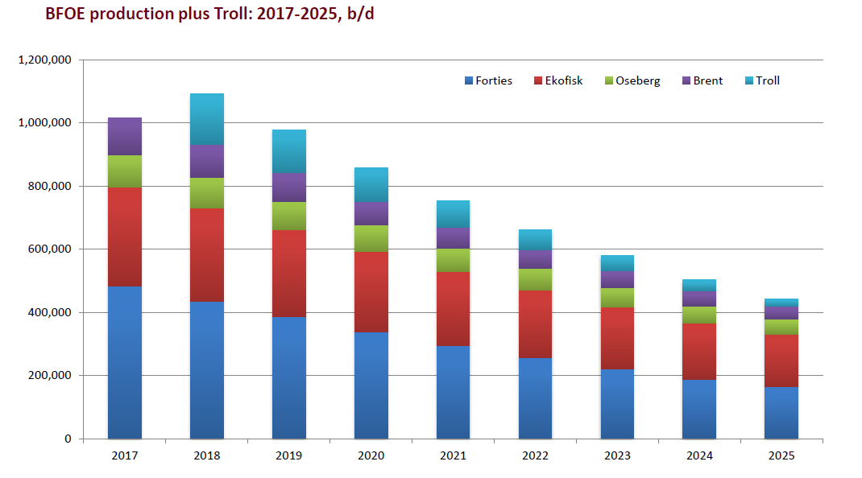
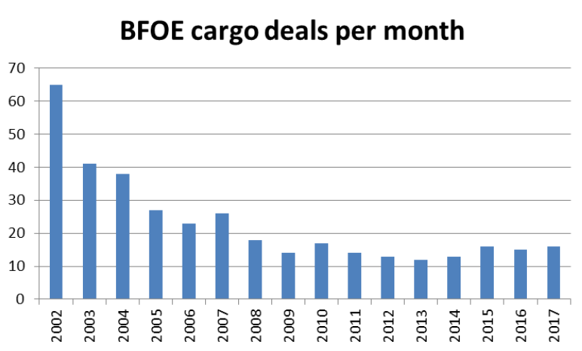
Dated Differential – Process & Volume
Platts Market On Close (MOC) Process
Platts assess the average lowest BFOET differential through trades/bids/offers in the Platts Window (daily 4.00-4.30PM)
Only activity in the Platts MOC window forms the basis for assessment (often see different prices in vs outside the window)
Historically Forties set the quote but has now become a mix (weighted average)
Production / Liquidity
BFOET production is on the decline. Addition of Troll has offset slightly but liquidity still reducing
Number of trades in the window is ~15-20 per month
Considerations ongoing to add further grades to the “basket” (e.g. Johan Sverdrup) or produce a delivered quote

Slide 7
Dated Diff Buyers, Sellers & Destinations
Sellers
50% of equity across 3 players – Statoil, Shell, Total
Non equity volume acquired through forward chains or spot deals
Limited number of sellers within the Platts MOC process (e.g. 5 sellers in May 2018) & usually non equity
ExxonMobil have typically sold our equity volume at forward value
Buyers
Main buyers are in NW Europe but volume to Asia now a regular movement (e.g. Forties to South Korea)
Volume often bought for storage (capturing market structure) and resold later, often cheaper and outside the window
Limited number of buyers within the Platts MOC process (e.g. 5 sellers in May 2018)
ExxonMobil limited buyer - Troll main intake and not through MOC process
Dated Brent Assessment
Majority of physical trades occur outside the Platts MOC process. End users typically not in the window
Limited number of participants in the window increases their influence
Volume sold out of region (e.g. Asia) or taken to own systems not included in the quote, thus reducing liquidity
Overall effect is that you see price dynamics in the prompt which can create exposure & opportunity!
Forties
Troll

Slide 8
Basis Risk – Dated / Front Month ICE Spread
Managing/hedging Dated exposure with ICE Brent leaves an underlying basis risk.
E.g. When European PI was 34MB vs target 27 MB = 7 MB exposure (if hedging using ICE)
E.g. U.S. Arbitrage cargoes to Europe converted from WTI to ICE Brent (left to float)
Dated Brent reflects a different time period and is influenced by different factors to ICE Brent
ICE Brent traded by huge number of players including banks, hedge funds, governments etc. Macro scale, ~ 1000 MB/day traded
Transition from ICE Brent to Dated using bespoke markets, EFPs, CFD’s, BFOE differentials
Volatility in DTD/ICE spread due to timing, prompt and micro factors impacting CFD’s/BFOE?
Hedging tools for exposure : Flat price exposure = ICE futures
Basis risk = CFD’s and DFL’s can help to manage Dated/ICE exposure

Slide 9
Brent Book
Brent exposure can be combined and managed in a single book – Brent Book
1. All exposures would be consolidated within the Brent Book which would be responsible for handling all Brent derivatives and positions (no longer within affiliate)
2. Responsible trader(s) would be solely active in and have expertise in the Brent market, taking responsibility from physical traders
3. Consolidated view allows capture of commercial margin through market view on basis risk/structure
Brent
Book
Consolidate exposures
Manage structure
Trade Brent Instruments (CFD’s, EFP’s)
Flat Price Exposure
ABT trades
Market structure in economics

Slide 10
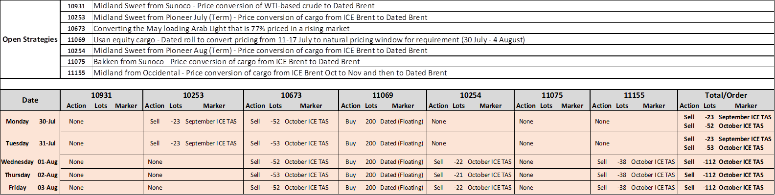
1. Consolidation of Strategies/Derivatives
Individual management of strategies becomes increasingly complex as activity grows:
Risk of taking offsetting positions
Increased likelihood of errors
Difficult to measure overall exposure, risk and P/L
Time intensive
Consolidating all positions in a Brent Book simplifies many of these challenges
Manual process started in LTO that combines hedging activity across all open Europe strategies
Current Process

Slide 11
1. Crude Purchases and Priced Inventory
Integration into proposed PI methodology:
Physical traders would purchase crude on existing pricing basis (e.g. 0/0/5 BL)
Brent Book would convert pricing to Dated Brent month average (of discharge) for sale into affiliate
Market Structure incorporated into deal economics and differential to refinery
Structure assessed through brokers, dated desk assessment or end of day spreads
Brent Book would have its own PI profile consolidating all exposures
Brent Book would take the decision on how to handle exposures – e.g. lock in conversion at deal time, take no immediate action etc.
Daily hedging of affiliate Priced Inventory and monthly rolls would also be managed by the Brent Book

Slide 12
2. Management of Exposure
Once combined within the Brent Book, positions can be managed on a daily, weekly and monthly basis through the numerous Brent instruments (e.g.):
Daily ICE Brent Futures
Weekly CFD’s
Monthly DFL’s
Dated Swaps/Rolls
Bespoke instruments
Data quality remains critical as does interaction with schedulers, traders, etc.
Trade Example:
WAF trader executes a deal with 0/0/5 BL pricing into TradeCo and month average sale pricing to a 3P
Brent Book would provide an assessment of market structure for the deal economics
Brent Book would take the exposure and manage accordingly (rather than WAF trader)
Exposure would be combined with exposure across all other ABT trades
Note: same would apply to US cargoes (ICE/DTD exposure) etc.

Slide 13
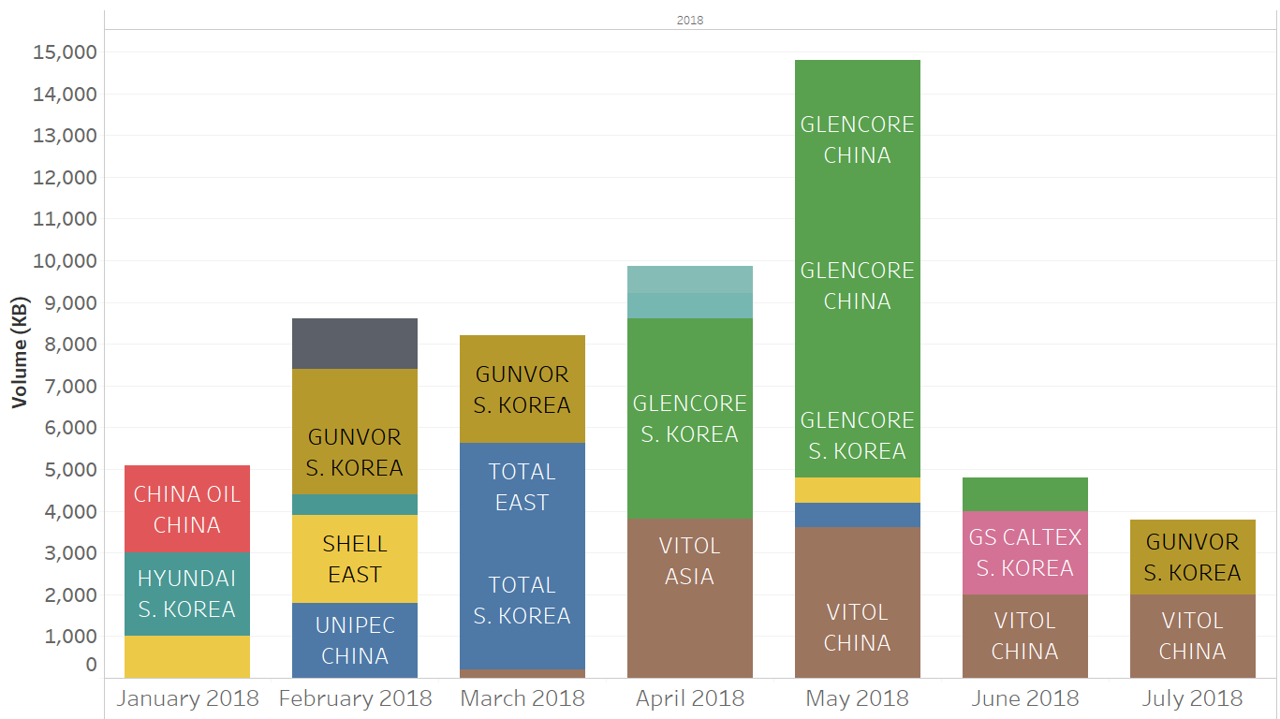
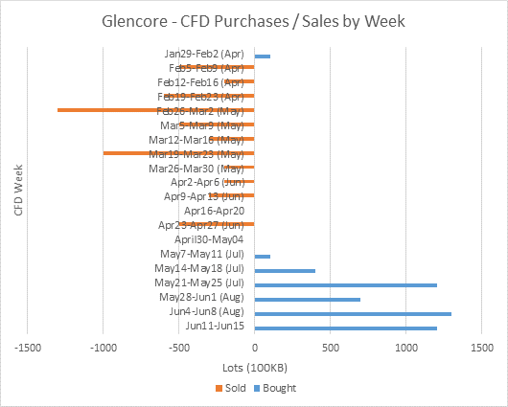
3. Market Dynamics & Forming Market Views
Brent trader being active in the market is able to form a view on spreads, exposure levels, market structure etc.
For example, may choose to avoid a certain pricing week or move EM exposure to a different period due to market activity and dynamics
Can be complimented by trading analytics:
Market Structure – ICE & CFD
Out of Region movements/ Arbitrage
CFD positions of competitors
Window activity and indicators
Competitor pricing exposures
Floating Storage levels

Slide 14
Brent Book Considerations / Next Steps
Tool to capture/consolidate all Dated exposure
Book and Desk Structure - split CFD , flat price etc
Staffing Requirements including non-traders
Risk Limits & VaR
Changes to existing Work Processes
Interaction with trading/optimisation/analysts/schedulers
Operationalization / Timeline

Slide 15
Back-Up

Slide 16
Dated Brent - how is it assessed?
Platts Assessment Formula
Dated Brent = ICE Brent (future) + EFP + CFD (for 10-30 period) + Lowest BFOET Diff
Forward BFOET
FUTURES 600-800 MB/Day | Regulated, traded via an exchange, traded in 1,000 barrel lots. Cash settled against ICE Brent index price at expiry or exchanged for physical via EFP
FORWARD 2-4 MB/Day | Contract to make or take delivery of a BFOE physical cargo (600 kb +/- 1%) Transacted at Fixed Price . Closed by nominating cargo 1 month in advance (passing in chains). Unregulated; transactions between two parties throughout the day Partials: Trade in lots of 100,000 barrels. Transacted in Platts MOC and “set” Forward Price.
Components of Dated Benchmark
EFP | EFP = Forward – Future; Links futures and forward contracts; OTC market An exchanged futures contract becomes a Cash BFOE contract.
CFD 2-4 MB/Day | CFD = Dated – Forward. Reflect the contango / backwardation in the market Typically traded and reported up to 8 weeks out; OTC market
DFL | DFL = Dated – Future, Longer range tool; quoted for (3 mo., 3qtrs., 3yrs) Allows comparison of long haul cargos (e.g., Saudi) that price off Futures.
Notes:
This is break down of where we ended up from our 2011 EM site assessments for Kearl processing. It represents the processing capabilities by site for both initial introduction of Kearl in Q4, 2012 and also potential capabilities for the next phase of Kearl in 2015.
The primary backstop sites are Joliet, Billings, Beaumont, Nanticoke, and Sarnia. USGC logistics limits the initial processing of Kearl to Beaumont refinery using the ~20 kbd of Pegasus pipeline space that is presently controlled by EM and also is used to ship Cold Lake. We will cover more of the logistics challenges for clearing of crude to the USGC later on in the package.
In addition to the site capabilities, this slide highlights the current site constraints and also whether or not a site has had the opportunity to process Shell’s PFT crude blend in a test run. When Shell’s Scotford upgrader experiences reliability problems, Shell places a blended PFT bitumen crude on the market at a price lower than both CLB and WCS crudes. In 2011, we were able to take advantage of processing a large volume (~900+ kbbls) at ‘4’ of our backstop sites to help set our operating envelopes for what Kearl could potentially look like as a PFT based crude. Additional information on the various types of Shell PFT crude blends can be found in the backup section of this presentation.
All of the EM sites are progressing through a Management of Change (MOC) work process, with action plans and projects to address any capability gaps required in their respective readiness for processing of Kearl. Sites in Bold have completed theirs. Operating cost estimates have been developed for each site. The un-optimized operating costs required will be up to 0.42 $/Kearl bbl.
Strathcona refinery was added to the mix, however, after the site review, the logistics challenges were steep and Kearl processing would mostly limited to the asphalt unit and only on certain grades of paving asphalt
Torrance was re-evaluated, however, with the low carbon fuels standards regulation they carry potential large discount on Western Canadian crudes.

Slide 17
ICE Brent
Two main time stamps
4.30 pm Platts base value for Dated quote
7.30 pm Settlement price (Saudi barrels)
CFD’s (Dtd vs Frontline futures) derivative hedge between Dtd and Platts MOPS
Dated to Front Line (DFL) derivative hedge between Dtd and Settlement
Notes:
This is break down of where we ended up from our 2011 EM site assessments for Kearl processing. It represents the processing capabilities by site for both initial introduction of Kearl in Q4, 2012 and also potential capabilities for the next phase of Kearl in 2015.
The primary backstop sites are Joliet, Billings, Beaumont, Nanticoke, and Sarnia. USGC logistics limits the initial processing of Kearl to Beaumont refinery using the ~20 kbd of Pegasus pipeline space that is presently controlled by EM and also is used to ship Cold Lake. We will cover more of the logistics challenges for clearing of crude to the USGC later on in the package.
In addition to the site capabilities, this slide highlights the current site constraints and also whether or not a site has had the opportunity to process Shell’s PFT crude blend in a test run. When Shell’s Scotford upgrader experiences reliability problems, Shell places a blended PFT bitumen crude on the market at a price lower than both CLB and WCS crudes. In 2011, we were able to take advantage of processing a large volume (~900+ kbbls) at ‘4’ of our backstop sites to help set our operating envelopes for what Kearl could potentially look like as a PFT based crude. Additional information on the various types of Shell PFT crude blends can be found in the backup section of this presentation.
All of the EM sites are progressing through a Management of Change (MOC) work process, with action plans and projects to address any capability gaps required in their respective readiness for processing of Kearl. Sites in Bold have completed theirs. Operating cost estimates have been developed for each site. The un-optimized operating costs required will be up to 0.42 $/Kearl bbl.
Strathcona refinery was added to the mix, however, after the site review, the logistics challenges were steep and Kearl processing would mostly limited to the asphalt unit and only on certain grades of paving asphalt
Torrance was re-evaluated, however, with the low carbon fuels standards regulation they carry potential large discount on Western Canadian crudes.

Slide 18
EFP’s – exchange of futures for physical
EFP bridges between the ICE market and Forward market
( CFDs then link between FWD and DTD)
EFP average +6 cab in 2018 i.e. forward higher than future
EFP valued based on Forward and Partials trading
Limited no of participants ~10
Trades of 100 KB – part of a forward cargo
Notes:
This is break down of where we ended up from our 2011 EM site assessments for Kearl processing. It represents the processing capabilities by site for both initial introduction of Kearl in Q4, 2012 and also potential capabilities for the next phase of Kearl in 2015.
The primary backstop sites are Joliet, Billings, Beaumont, Nanticoke, and Sarnia. USGC logistics limits the initial processing of Kearl to Beaumont refinery using the ~20 kbd of Pegasus pipeline space that is presently controlled by EM and also is used to ship Cold Lake. We will cover more of the logistics challenges for clearing of crude to the USGC later on in the package.
In addition to the site capabilities, this slide highlights the current site constraints and also whether or not a site has had the opportunity to process Shell’s PFT crude blend in a test run. When Shell’s Scotford upgrader experiences reliability problems, Shell places a blended PFT bitumen crude on the market at a price lower than both CLB and WCS crudes. In 2011, we were able to take advantage of processing a large volume (~900+ kbbls) at ‘4’ of our backstop sites to help set our operating envelopes for what Kearl could potentially look like as a PFT based crude. Additional information on the various types of Shell PFT crude blends can be found in the backup section of this presentation.
All of the EM sites are progressing through a Management of Change (MOC) work process, with action plans and projects to address any capability gaps required in their respective readiness for processing of Kearl. Sites in Bold have completed theirs. Operating cost estimates have been developed for each site. The un-optimized operating costs required will be up to 0.42 $/Kearl bbl.
Strathcona refinery was added to the mix, however, after the site review, the logistics challenges were steep and Kearl processing would mostly limited to the asphalt unit and only on certain grades of paving asphalt
Torrance was re-evaluated, however, with the low carbon fuels standards regulation they carry potential large discount on Western Canadian crudes.

